Slide 1

Geometry
Unit 7, Lesson 2 Defining Sine and Cosine Volume 1, pg. 374

Slide 2


Benchmarks
MA.912.T.1.1
Define trigonometric ratios for acute angles in right triangles.
MA.912.T.1.2
Solve mathematical and real-world problems involving right triangles using trigonometric ratios and the Pythagorean Theorem.
volume 1, pg. 374

Slide 3
Integrated Mathematical Thinking and Reasoning Standards
MA.K12.MTR.1.1 Actively participate in effortful learning both individually and collectively.
MA.K12.MTR.2.1 Demonstrate understanding by representing problems in multiple ways.
MA.K12.MTR.4.1 Engage in discussions that reflect on the mathematical thinking of self and others.
MA.K12.MTR.5.1 Use patterns and structure to help understand and connect mathematical concepts.
MA.K12.MTR.6.1 Assess the reasonableness of solutions.
volume 1, pg. 374

Slide 4

Learning Target
I can define sine and cosine using similar triangles.
volume 1, pg. 374

Slide 5

Warm-Up
volume 1, pg. 375

Slide 6
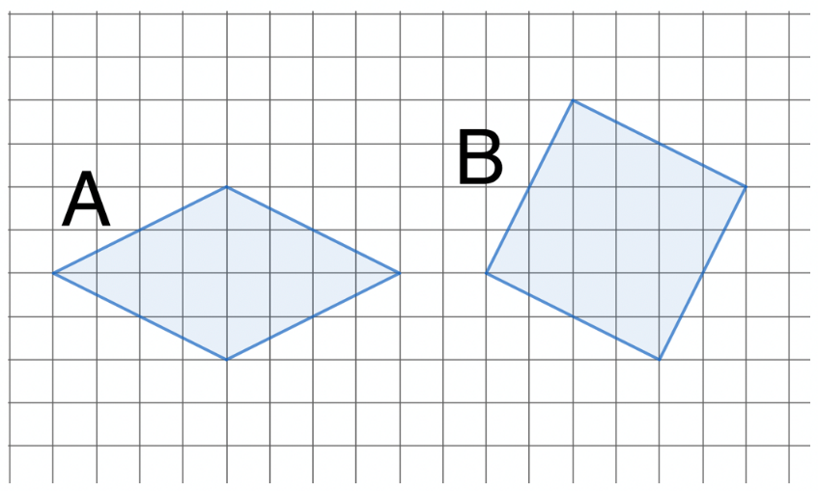
7.2.1 Warm-Up: Which Region Is Larger?
Two grids are shown with regions shaded.
Which shaded region is larger?
Explain your reasoning.
volume 1, pg. 375

Slide 7

Exploration
volume 1, pg. 375

Slide 8

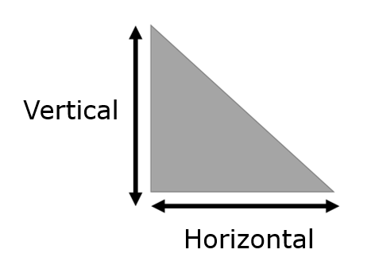
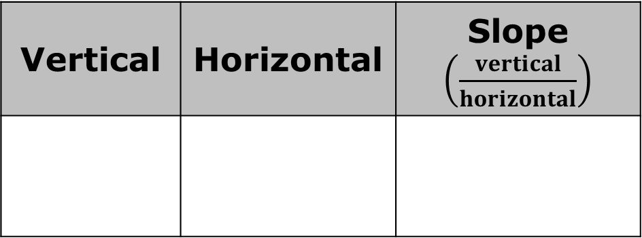
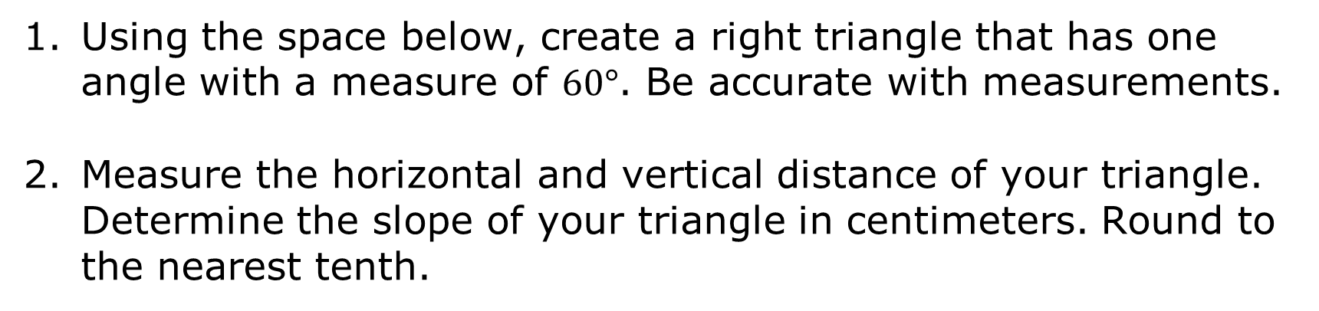
7.2.2 Exploration: Similar Right Triangles
Using the space below, create a right triangle that has one angle with a measure of $60°$. Be accurate with measurements.
Measure the horizontal and vertical distance of your triangle. Determine the slope of your triangle in centimeters. Round to the nearest tenth.
Vertical | Horizontal | Slope $\left(\frac{vertical}{horizontal}\right)$
volume 1, pg. 375

Slide 9
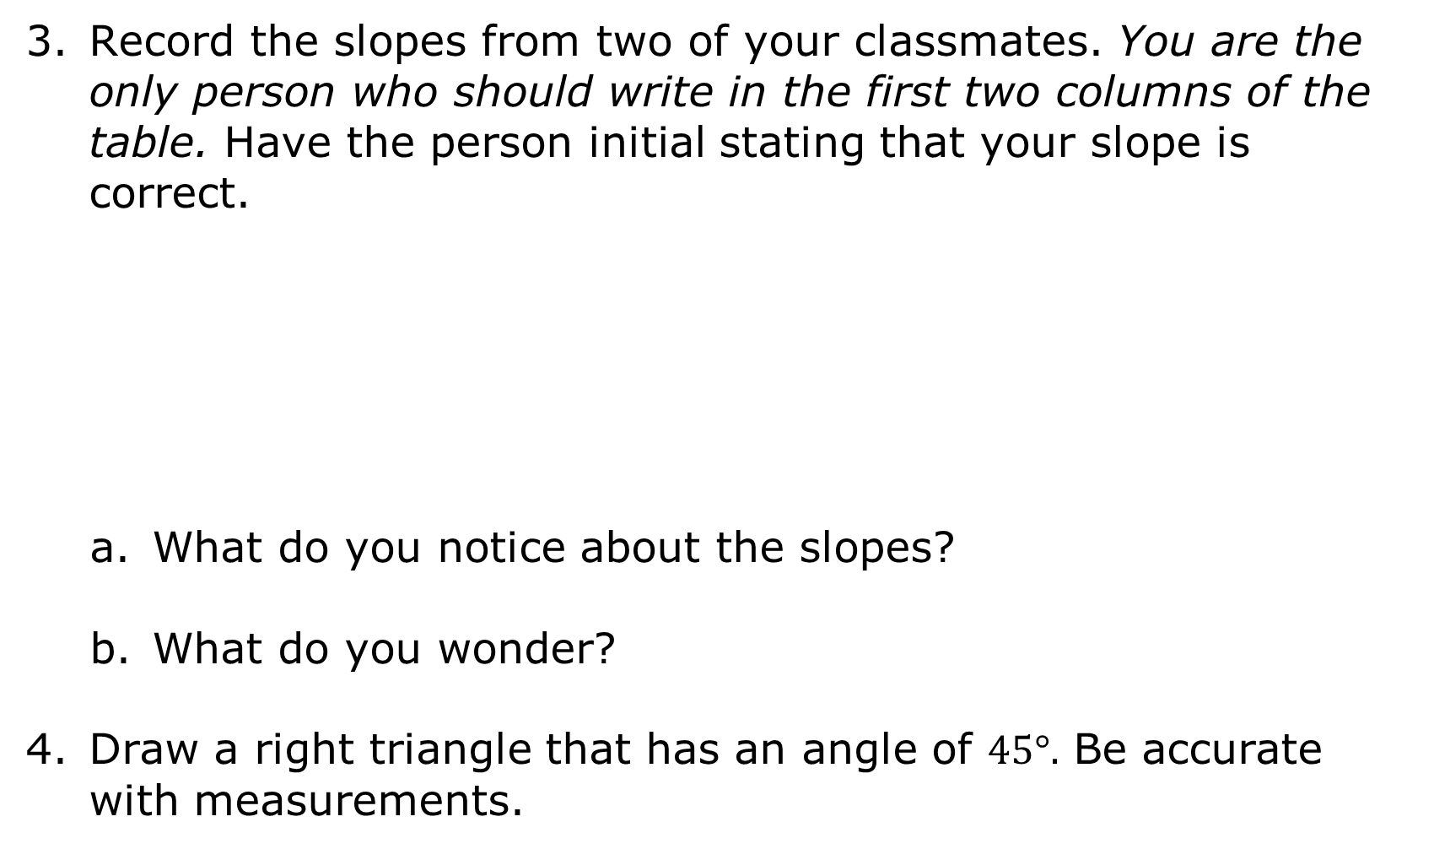
Record the slopes from two of your classmates. You are the only person who should write in the first two columns of the table. Have the person initial stating that your slope is correct.
What do you notice about the slopes?
What do you wonder?
Draw a right triangle that has an angle of $45°.$ Be accurate with measurements.
Classmate | Slope | Initials
volume 1, pg. 376

Slide 10
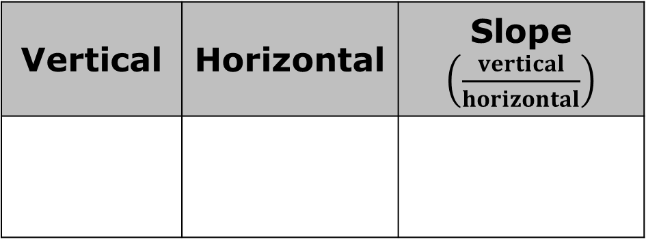
Measure the horizontal and vertical distance of your triangle. Determine the slope of your triangle in centimeters. Round to the nearest tenth.
Vertical | Horizontal | Slope $\left(\frac{vertical}{horizontal}\right)$
volume 1, pg. 376

Slide 11
Record the slopes from two of your classmates. You are the only person who should write in the second column of the table. Have the person initial stating that your slope is correct.
Classmate | Slope | Initials
What do you notice about the slopes?
What do you wonder?
volume 1, pg. 376

Slide 12
Ask two classmates for the “Notice and Wonder” what they wrote for both triangles. Record their responses below. You are the only person who should write in the first three columns of the table. Have the person initial that it is written correctly.
Classmate | Notice | Wonder | Initials
volume 1, pg. 377

Slide 13
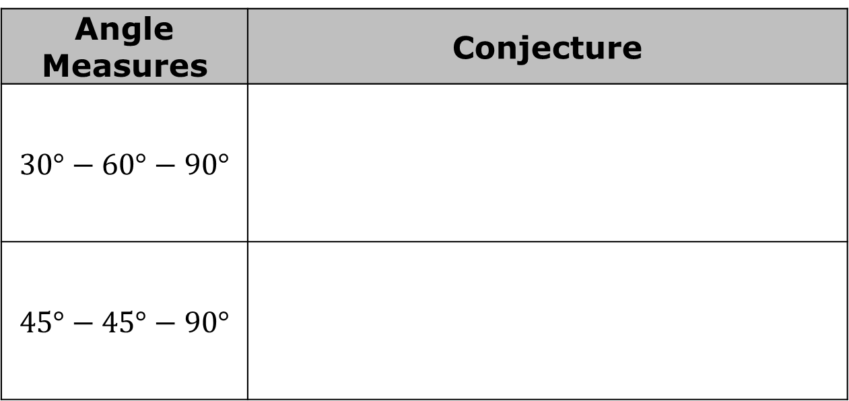
Write a conjecture for each of the right triangles that were drawn.
Angle Measures | Conjecture
$$30°−60°−90°$$
$$45°−45°−90°$$
volume 1, pg. 377

Slide 14

The triangles drawn by you and your classmates during the Exploration vary. Using either the triangles explored in Questions 1-3 or 4-6, explain why these triangles are similar.
Right triangles with one other congruent angle are similar because of AA similarity.
volume 1, pg. 377

Slide 15

Collaboration
volume 1, pg. 378

Slide 16

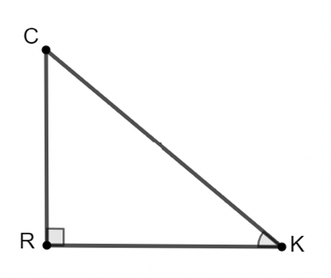
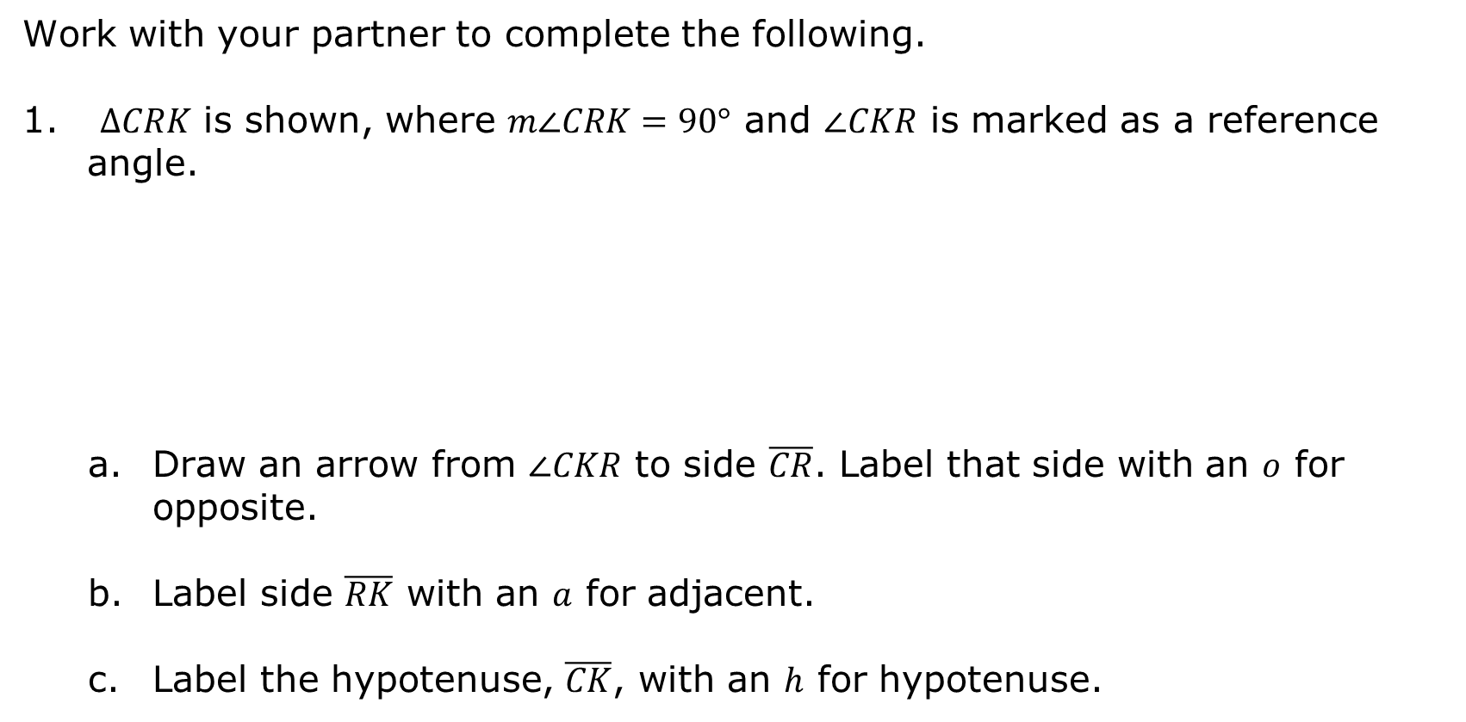
7.2.3 Collaboration: Introduction to Trigonometric Ratios
Work with your partner to complete the following.
$∆CRK$ is shown, where $m∠CRK=90°$ and $∠CKR$ is marked as a reference angle.
Draw an arrow from $∠CKR$ to side $\overline{CR}$. Label that side with an $o$ for opposite.
Label side $\overline{RK}$ with an $a$ for adjacent.
Label the hypotenuse, $\overline{CK}$, with an $h$ for hypotenuse.
volume 1, pg. 378

Slide 17
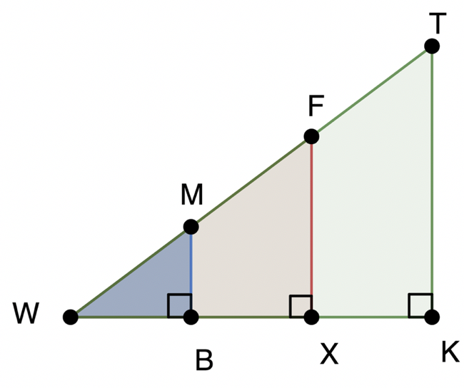
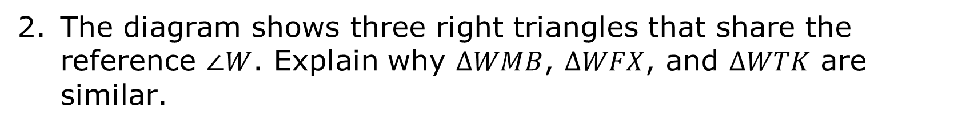
The diagram shows three right triangles that share the reference $∠W$. Explain why $∆WMB$, $∆WFX$, and $∆WTK$ are similar.
volume 1, pg. 378

Slide 18
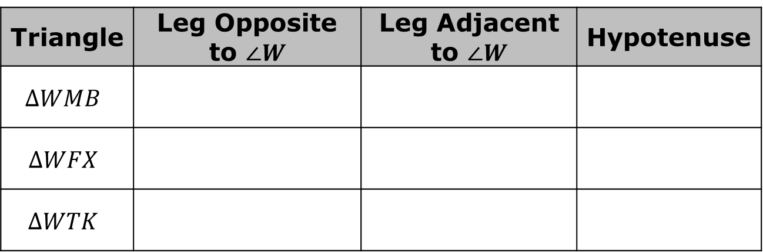
Complete the table.
Triangle | Leg Opposite to $∠W$ | Leg Adjacent to $∠W$ | Hypotenuse
$$∆WMB$$
$$∆WFX$$
$$∆WTK$$
volume 1, pg. 378

Slide 19
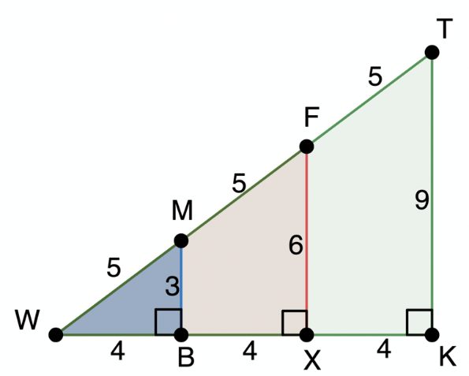
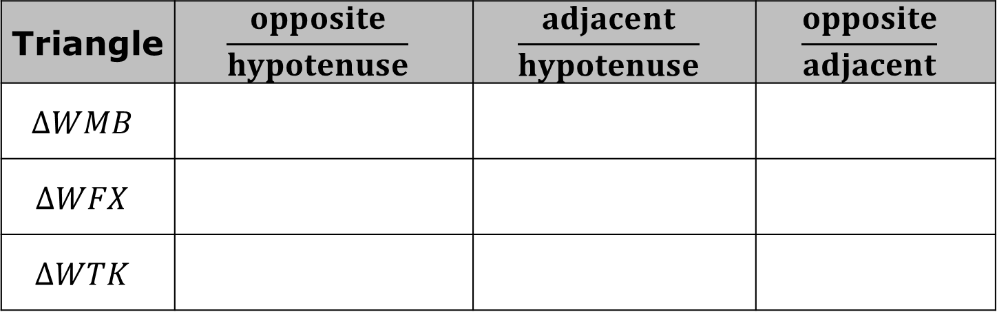
The diagram shows measurements for the three triangles.
Complete the table using $∠W$ as the reference angle.
Triangle | $$\frac{opposite}{hypotenuse}$$ | $$\frac{adjacent}{hypotenuse}$$ | $$\frac{opposite}{adjacent}$$
$$∆WMB$$
$$∆WFX$$
$$∆WTK$$
volume 1, pg. 379

Slide 20

Bring It Together
volume 1, pg. 379

Slide 21

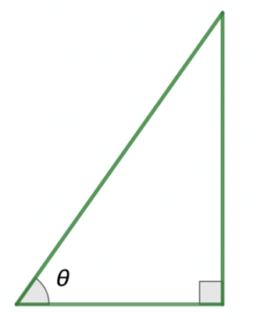

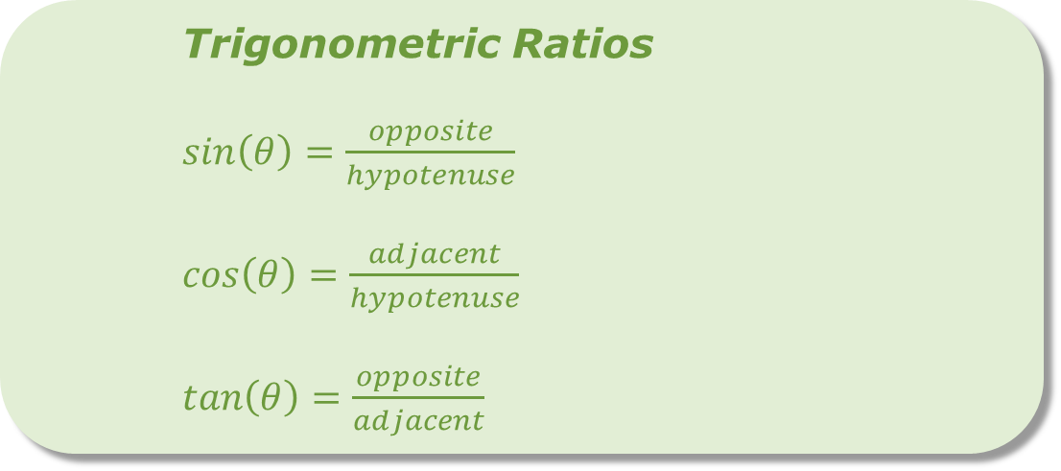
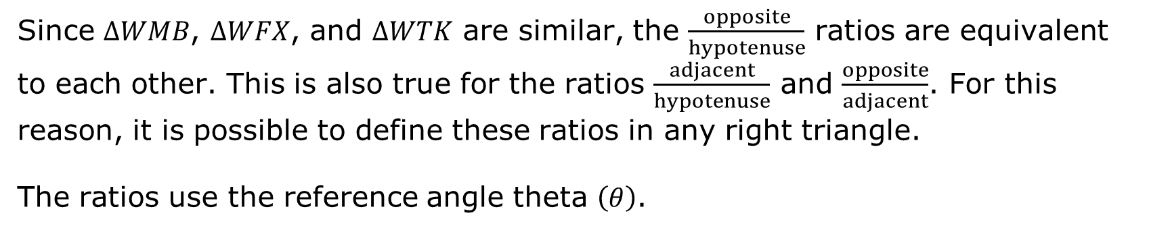
7.2.4 Bring It Together: Trigonometric Ratios
Since $∆WMB$, $∆WFX$, and $∆WTK$ are similar, the $\frac{opposite}{hypotenuse}$ ratios are equivalent to each other. This is also true for the ratios $\frac{adjacent}{hypotenuse}$ and $\frac{opposite}{adjacent}$. For this reason, it is possible to define these ratios in any right triangle.
The ratios use the reference angle theta $\left(θ\right)$.
Trigonometric Ratios
$sin\left(θ\right)=\frac{opposite}{hypotenuse}$
$cos\left(θ\right)=\frac{adjacent}{hypotenuse}$
$tan\left(θ\right)=\frac{opposite}{adjacent}$
volume 1, pg. 379

Slide 22

Guided Practice
volume 1, pg. 380

Slide 23

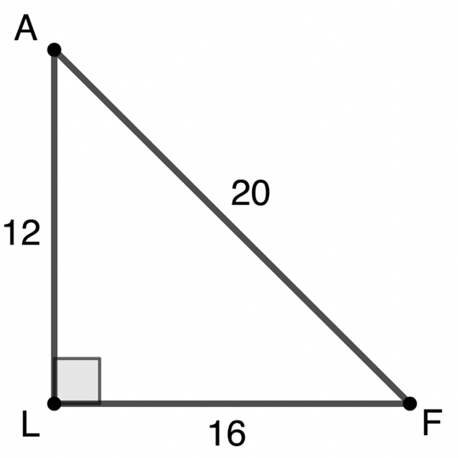
7.2.5 Guided Practice: Trigonometric Ratios
$∆FLA$ is shown. $m∠ALF=90°, AL=12, LF=16,$ and $AF=20.$
volume 1, pg. 380

Slide 24
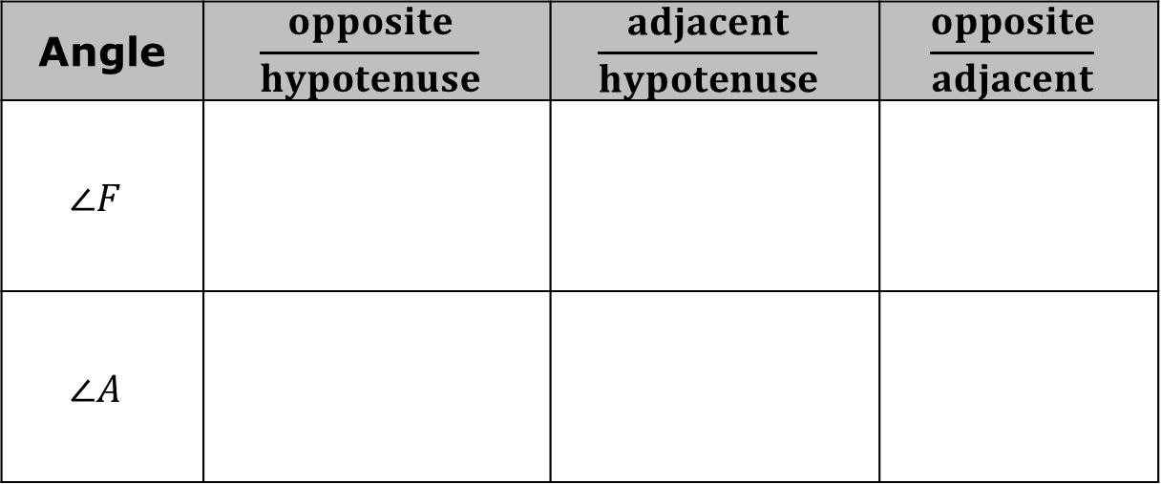
Complete the table using each angle as the reference angle.
Angle | $$\frac{opposite}{hypotenuse}$$ | $$\frac{adjacent}{hypotenuse}$$ | $$\frac{opposite}{adjacent}$$
$$∠F$$
$$∠A$$
volume 1, pg. 380

Slide 25
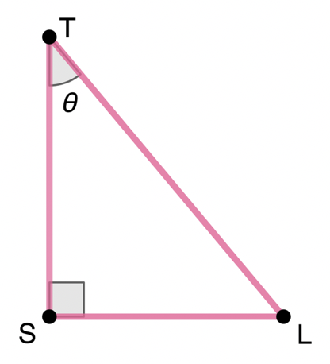
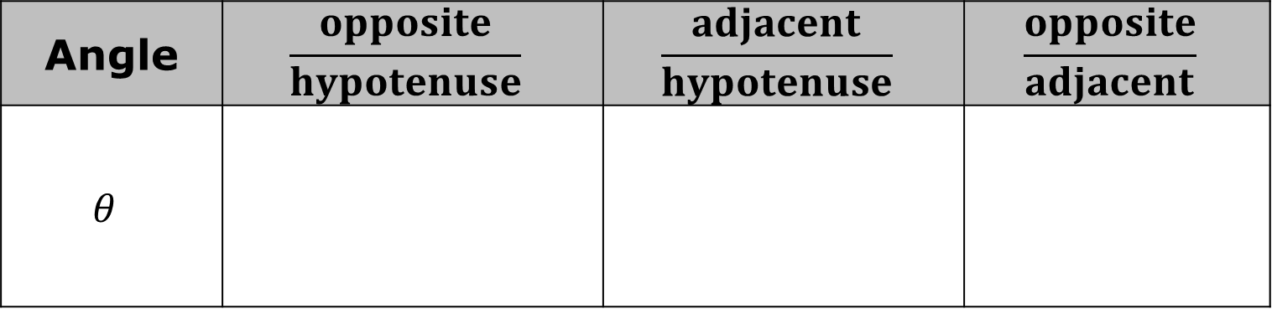
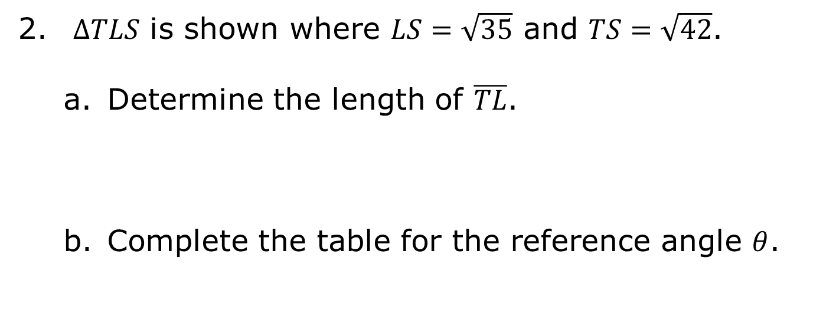
$∆TLS$ is shown where $LS=\sqrt{35}$ and $TS=\sqrt{42}$.
Determine the length of $\overline{TL}$.
Complete the table for the reference angle $θ$.
Angle | $$\frac{opposite}{hypotenuse}$$ | $$\frac{adjacent}{hypotenuse}$$ | $$\frac{opposite}{adjacent}$$
$$θ$$
volume 1, pg. 380

Slide 26

Wrap-Up
volume 1, pg. 381

Slide 27
7.2.6 Wrap-Up: Cool Down
Your friend is absent today and will need the notes from class. Write a quick note to explain what was missed in today’s lesson.
volume 1, pg. 381

